Slide 1
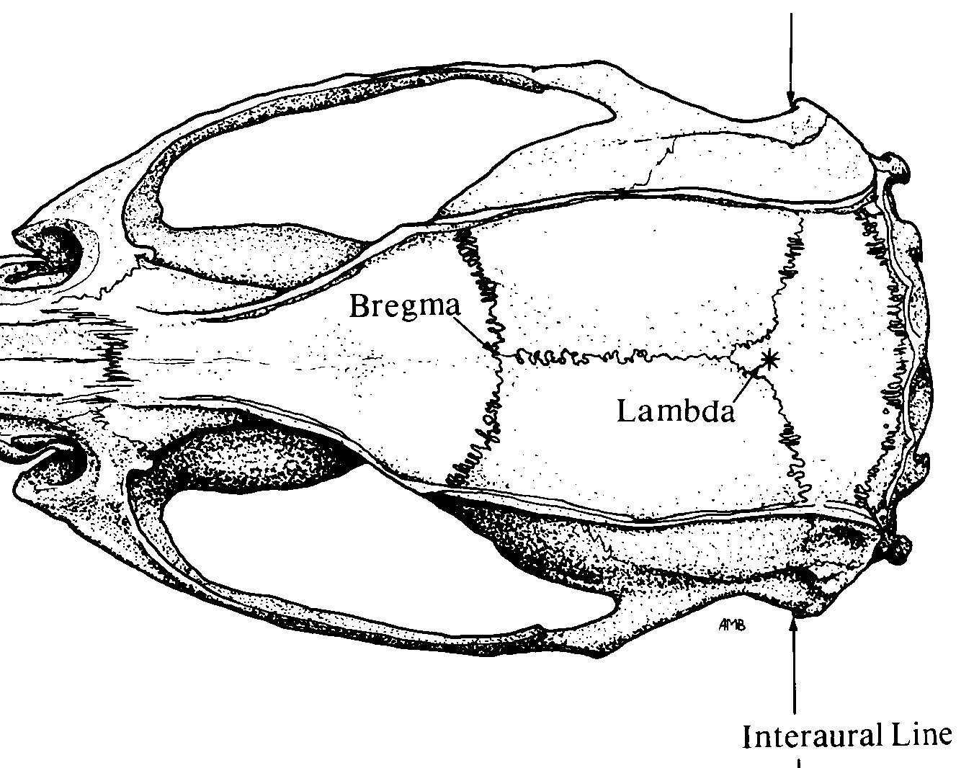

Pinnacle 3-Channel layout
Implant Map
Pin-out
1 GND | 2 EEG2 (EMG) | 3 EEG3 (M1, twisted)
4 COMM | 5 EEG1 (RPC) | 6 EEG3 (M1, twisted)
White out
*
*
❸ ❻
Bregma
Stereotaxic Coordinates
Location | Bregma | Midline
M1 | +1.1 (anterior) | ±1.5 (lateral)
Parietal | -2 (posterior) | +1.5 (lateral, right only)
EMG | Nuchal musc
❺
Lambda
❹
❶
❷
Nuchal muscle
*
Anchor screw
Adjust ratio $=\frac{Measured X B−L}{Reference X B−L}$

